Slide 1
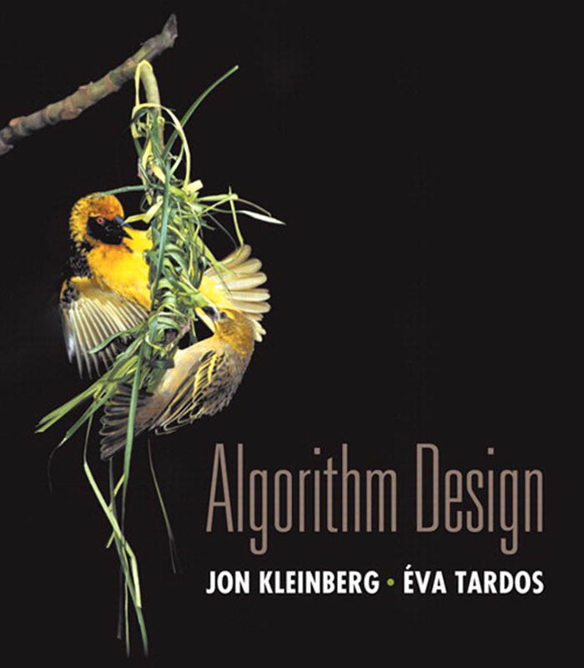

8. Intractability I
poly-time reductions
packing and covering problems
constraint satisfaction problems
sequencing problems
partitioning problems
graph coloring
numerical problems
Lecture slides by Kevin Wayne Copyright © 2005 Pearson-Addison Wesley
http:// www.cs.princeton.edu/ ~wayne/ kleinberg-tardos
Last updated on 1/5/22 12:36 PM

Slide 2


8. Intractability I
poly-time reductions
packing and covering problems
constraint satisfaction problems
sequencing problems
partitioning problems
graph coloring
numerical problems
Section 8.1

Slide 3
Algorithm design patterns and antipatterns
Algorithm design patterns.
・Greedy.
・Divide and conquer.
・Dynamic programming.
・Duality.
・Reductions.
・Local search.
・Randomization.
Algorithm design antipatterns.
・NP-completeness.
・PSPACE-completeness.
・Undecidability.
O(n^{k}) algorithm unlikely.
O(n^{k}) certification algorithm unlikely. No algorithm possible.

Slide 4
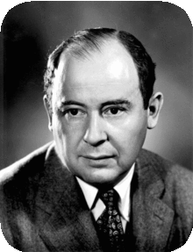
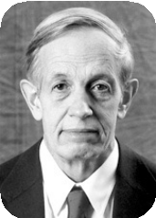
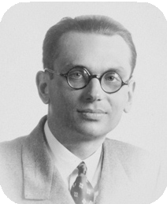




Classify problems according to computational requirements
Q. Which problems will we be able to solve in practice?
A working definition. Those with poly-time algorithms.
von Neumann (1953)
Nash (1955)
Gödel (1956)
Cobham (1964)
Edmonds (1965)
Rabin (1966)
Turing machine, word RAM, uniform circuits, …
Theory. Definition is broad and robust.
constants tend to be small, e.g., 3 n ²
Practice. Poly-time algorithms scale to huge problems.

Slide 5
Classify problems according to computational requirements
Q. Which problems will we be able to solve in practice?
A working definition. Those with poly-time algorithms.
yes | probably no
shortest path | longest path
min cut | max cut
2-satisfiability | 3-satisfiability
planar 4-colorability | planar 3-colorability
bipartite vertex cover | vertex cover
matching | 3d-matching
primality testing | factoring
linear programming | integer linear programming

Slide 6
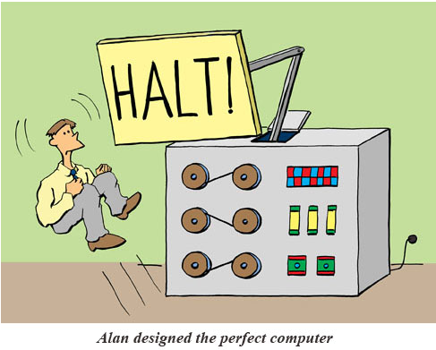
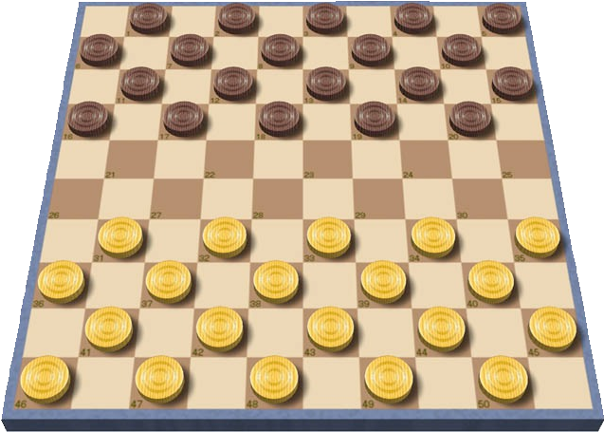
Classify problems
Desiderata. Classify problems according to those that can be solved in polynomial time and those that cannot.
input size = c + log k
Provably requires exponential time.
・Given a constant-size program, does it halt in at most k steps?
・Given a board position in an n-by-n generalization of checkers, can black guarantee a win?
using forced capture rule
Frustrating news. Huge number of fundamental problems have defied classification for decades.

Slide 7

What are reductions?
网络视频
https://www.youtube.com/watch?v=U4yGQp5aCTM
温馨提示：此视频框在点击“上传手机课件”时会进行转换，用手机进行观看时则会变为可点击的视频。此视频框可被拖动移位和修改大小。

Slide 8
Poly-time reductions
Desiderata′. Suppose we could solve problem Y in polynomial time. What else could we solve in polynomial time?
Reduction. Problem X polynomial-time (Cook) reduces to problem Y if arbitrary instances of problem X can be solved using:
・Polynomial number of standard computational steps, plus
・Polynomial number of calls to oracle that solves problem Y.
computational model supplemented by special piece of hardware that solves instances of Y in a single step
instance I (of X)
Algorithm for Y
solution S to I
Algorithm for X

Slide 9
Poly-time reductions
Desiderata′. Suppose we could solve problem Y in polynomial time. What else could we solve in polynomial time?
Reduction. Problem X polynomial-time (Cook) reduces to problem Y if arbitrary instances of problem X can be solved using:
・Polynomial number of standard computational steps, plus
・Polynomial number of calls to oracle that solves problem Y.
Notation. X ≤ _{P} Y.
Note. We pay for time to write down instances of Y sent to oracle ⇒
instances of Y must be of polynomial size.
Novice mistake. Confusing X ≤ _{P} Y with Y ≤ _{P} X.

Slide 10

Intractability: quiz 1
Suppose that X ≤ _{P} Y. Which of the following can we infer?
If X can be solved in polynomial time, then so can Y.
X can be solved in poly time iff Y can be solved in poly time.
If X cannot be solved in polynomial time, then neither can Y.
If Y cannot be solved in polynomial time, then neither can X.
10

Slide 11
Intractability: quiz 2
Which of the following poly-time reductions are known?
Find-Max-Flow ≤ _{P} Find-Min-Cut.
Find-Min-Cut ≤ _{P} Find-Max-Flow.
Both A and B.
Neither A nor B.
O(mn²) time: Dinitz’ algorithm
O(m) time: given max flow f,
let A = set of nodes reachable from s in Gf
11

Slide 12
Poly-time reductions
Design algorithms. If X ≤ _{P} Y and Y can be solved in polynomial time, then X can be solved in polynomial time.
Establish intractability. If X ≤ _{P} Y and X cannot be solved in polynomial time, then Y cannot be solved in polynomial time.
Establish equivalence. If both X ≤ _{P} Y and Y ≤ _{P} X, we use notation X ≡ _{P} Y. In this case, X can be solved in polynomial time iff Y can be.
Bottom line. Reductions classify problems according to relative difficulty.
11

Slide 13
P and NP problems
网络视频
https://www.youtube.com/watch?v=pQsdygaYcE4
温馨提示：此视频框在点击“上传手机课件”时会进行转换，用手机进行观看时则会变为可点击的视频。此视频框可被拖动移位和修改大小。

Slide 14
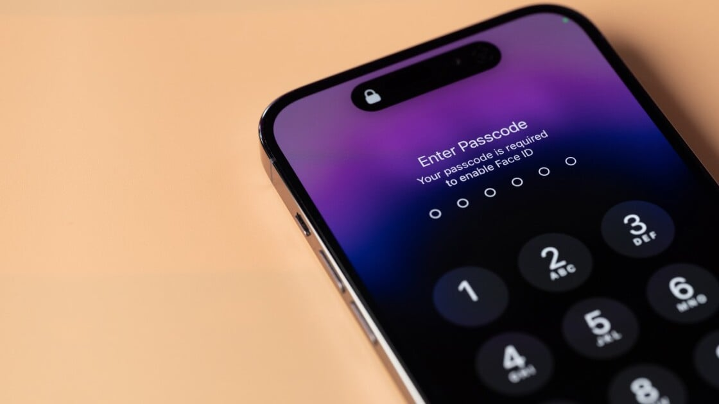
NP problem are very common
Exam Timetabling — Schedule Feasibility
Travel Planning — Budget-constrained Trip
Shopping — Budget Packing
Seating at a Dinner — Friend Grouping
Office Task Assignment — Staff Scheduling

Slide 15
8. Intractability I
poly-time reductions
packing and covering problems
constraint satisfaction problems
sequencing problems
partitioning problems
graph coloring
numerical problems
Section 8.1

Slide 16
Independent set
INDEPENDENT-SET. Given a graph G = (V, E) and an integer k, is there a subset of k (or more) vertices such that no two are adjacent?
Ex. Is there an independent set of size ≥ 6 ? Ex. Is there an independent set of size ≥ 7 ?
independent set of size 6

Slide 17
Vertex cover
VERTEX-COVER. Given a graph G = (V, E) and an integer k, is there a subset of k (or fewer) vertices such that each edge is incident to at least one vertex in the subset?
Ex. Is there a vertex cover of size ≤ 4 ? Ex. Is there a vertex cover of size ≤ 3 ?
independent set of size 6
vertex cover of size 4

Slide 18
Intractability: quiz 3
Consider the following graph G. Which are true?
The white vertices are a vertex cover of size 7.
The black vertices are an independent set of size 3.
Both A and B.
Neither A nor B.
15

Slide 19
Vertex cover and independent set reduce to one another
Theorem. INDEPENDENT-SET ≡ _{P} VERTEX-COVER.
Pf. We show S is an independent set of size k iff V − S is a vertex cover of size n – k.
independent set of size 6
vertex cover of size 4

Slide 20
Vertex cover and independent set reduce to one another
Theorem. INDEPENDENT-SET ≡ _{P} VERTEX-COVER.
Pf. We show S is an independent set of size k iff V − S is a vertex cover of size n – k.
⇒
・Let S be any independent set of size k.
・V − S is of size n – k.
・Consider an arbitrary edge (u, v) ∈ E.
・S independent ⇒ either u ∉ S, or v ∉ S, or both.
⇒ either u ∈ V − S, or v ∈ V − S, or both.
・Thus, V − S covers (u, v). ▪
⇐
・Let V − S be any vertex cover of size n – k.
・S is of size k.
・Consider an arbitrary edge (u, v) ∈ E.
・V − S is a vertex cover ⇒ either u ∈ V − S, or v ∈ V − S, or both.
⇒ either u ∉ S, or v ∉ S, or both.
・Thus, S is an independent set. ▪

Slide 21
Set cover
SET-COVER. Given a set U of elements, a collection S of subsets of U, and an integer k, are there ≤ k of these subsets whose union is equal to U ?
Sample application.
・m available pieces of software.
・Set U of n capabilities that we would like our system to have.
・The i^{th} piece of software provides the set S_{i} ⊆ U of capabilities.
・Goal: achieve all n capabilities using fewest pieces of software.
U = { 1, 2, 3, 4, 5, 6, 7 }
S_{a} = { 3, 7 }
S_{c} = { 3, 4, 5, 6 }
S_{e} = { 1 }
k = 2
S_{b} = { 2, 4 }
S_{d} = { 5 }
S_{f} = { 1, 2, 6, 7 }
a set cover instance

Slide 22
Intractability: quiz 4
Given the universe U = { 1, 2, 3, 4, 5, 6, 7 } and the following sets, which is the minimum size of a set cover?
A. 1
U = { 1, 2, 3, 4, 5, 6, 7 }
S_{a} = { 1, 4, 6 }
S_{c} = { 1, 2, 3, 6 }
S_{e} = { 2, 6, 7 }
S_{b} = { 1, 6, 7 }
S_{d} = { 1, 3, 5, 7 }
S_{f} = { 3, 4, 5 }
B. 2
C. 3
D. None of the above.
20

Slide 23
Vertex cover reduces to set cover
Theorem. VERTEX-COVER ≤ _{P} SET-COVER.
Pf. Given a VERTEX-COVER instance G = (V, E) and k, we construct a SET-COVER instance (U, S, k) that has a set cover of size k iff G has a vertex cover of size k.
Construction.
・Universe U = E.
・Include one subset for each node v ∈ V : S_{v} = {e ∈ E : e incident to v }.
a
b
e₇
e₂
e
e₄
U = { 1, 2, 3, 4, 5, 6, 7 }
3
S_{a} = { 3, 7 }
S_{c} = { 3, 4, 5, 6 }
S_{e} = { 1 }
S_{b} = { 2, 4 }
S_{d} = { 5 }
S_{f} = { 1, 2, 6, 7 }
f
e₆
c
e₁
e₅
e
d
vertex cover instance
(k = 2)
set cover instance
(k = 2)

Slide 24
Vertex cover reduces to set cover
Lemma. G = (V, E) contains a vertex cover of size k iff (U, S, k) contains a set cover of size k.
Pf. ⇒ Let X ⊆ V be a vertex cover of size k in G.
・Then Y = { Sv : v ∈ X } is a set cover of size k. ▪
“yes” instances of VERTEX-COVER are solved correctly
a
b
e₇
e₂
e
e₄
U = { 1, 2, 3, 4, 5, 6, 7 }
3
S_{a} = { 3, 7 }
S_{c} = { 3, 4, 5, 6 }
S_{e} = { 1 }
S_{b} = { 2, 4 }
S_{d} = { 5 }
S_{f} = { 1, 2, 6, 7 }
f
e₆
c
e₁
e₅
e
d
vertex cover instance
(k = 2)
set cover instance
(k = 2)

Slide 25
Vertex cover reduces to set cover
Lemma. G = (V, E) contains a vertex cover of size k iff (U, S, k) contains a set cover of size k.
Pf. ⇐ Let Y ⊆ S be a set cover of size k in (U, S, k).
・Then X = { v : Sv ∈ Y } is a vertex cover of size k in G. ▪
“no” instances of VERTEX-COVER are solved correctly
a
b
e₇
e₂
e
e₄
U = { 1, 2, 3, 4, 5, 6, 7 }
3
S_{a} = { 3, 7 }
S_{c} = { 3, 4, 5, 6 }
S_{e} = { 1 }
S_{b} = { 2, 4 }
S_{d} = { 5 }
S_{f} = { 1, 2, 6, 7 }
f
e₆
c
e₁
e₅
e
d
vertex cover instance
(k = 2)
set cover instance
(k = 2)

Slide 26
8. Intractability I
poly-time reductions
packing and covering problems
constraint satisfaction problems
sequencing problems
partitioning problems
graph coloring
numerical problems
Section 8.2

Slide 27
Satisfiability
Literal.
A Boolean variable or its negation.
x_{i} or x_{i}
Clause. A disjunction of literals.
C_{j} = x₁ ∨ x₂ ∨ x₃
Conjunctive normal form (CNF). A propositional formula Φ that is a conjunction of clauses.
Φ = C₁ ∧ C₂ ∧ C₃ ∧ C₄
SAT. Given a CNF formula Φ, does it have a satisfying truth assignment? 3-SAT. SAT where each clause contains exactly 3 literals
(and each literal corresponds to a different variable).
Φ = ( x₁ ∨ x₂ ∨ x₃) ∧ ( x₁ ∨ x₂ ∨ x₃) ∧ ( x₁ ∨ x₂ ∨ x₄ )
yes instance: x₁ = true, x₂ = true, x₃ = false, x₄ = false
Key application. Electronic design automation (EDA).

Slide 28
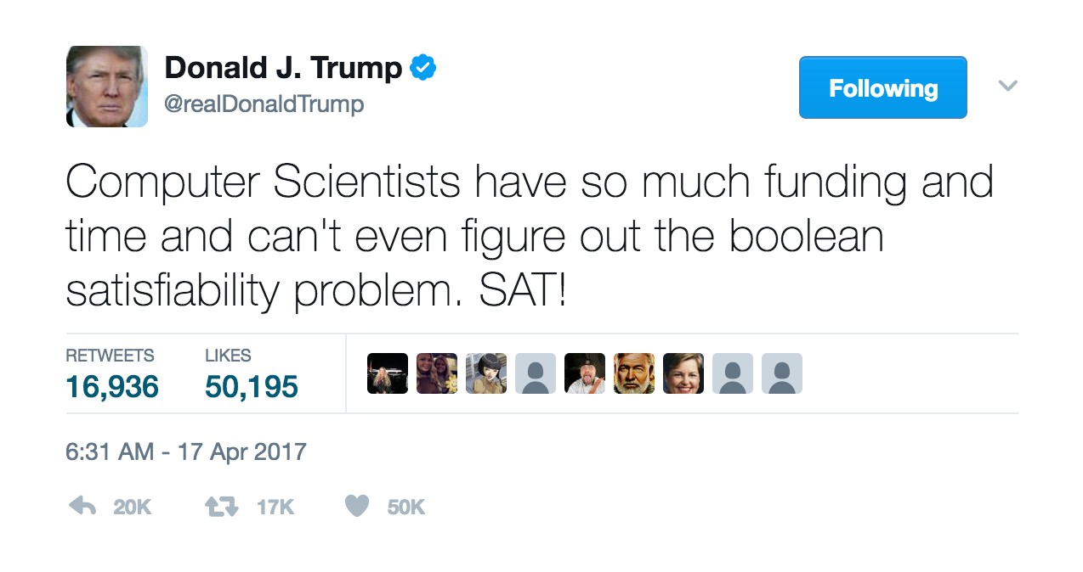
Satisfiability is hard
Scientific hypothesis. There does not exist a poly-time algorithm for 3-SAT.
P vs. NP. This hypothesis is equivalent to P ≠ NP conjecture.
https://www.facebook.com/pg/npcompleteteens

Slide 29
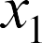
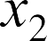





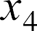
3-satisfiability reduces to independent set
Theorem. 3-SAT ≤ P INDEPENDENT-SET.
Pf. Given an instance Φ of 3-SAT, we construct an instance (G, k) of INDEPENDENT-SET that has an independent set of size k = ⎮Φ⎮ iff Φ is satisfiable.
Construction.
・G contains 3 nodes for each clause, one for each literal.
・Connect 3 literals in a clause in a triangle.
・Connect literal to each of its negations.
G
k = 3
Φ
= ( x₁ ∨ x₂ ∨ x₃) ∧ ( x₁ ∨ x₂ ∨ x₃)
∧ ( x₁ ∨ x₂ ∨ x₄ )

Slide 30
3-satisfiability reduces to independent set
Lemma.
Φ is satisfiable iff G contains an independent set of size k = ⎮Φ⎮.
Pf. ⇒ Consider any satisfying assignment for Φ.
・Select one true literal from each clause/triangle.
・This is an independent set of size k = ⎮Φ⎮. ▪
“yes” instances of 3-SAT are solved correctly
G
k = 3
Φ
= ( x₁ ∨ x₂ ∨ x₃) ∧ ( x₁ ∨ x₂ ∨ x₃)
∧ ( x₁ ∨ x₂ ∨ x₄ )

Slide 31
3-satisfiability reduces to independent set
Lemma.
Φ is satisfiable iff G contains an independent set of size k = ⎮Φ⎮.
Pf. ⇐ Let S be independent set of size k.
・S must contain exactly one node in each triangle.
・Set these literals to true (and remaining literals consistently).
・All clauses in Φ are satisfied. ▪
“no” instances of 3-SAT are solved correctly
G
k = 3
Φ
= ( x₁ ∨ x₂ ∨ x₃) ∧ ( x₁ ∨ x₂ ∨ x₃)
∧ ( x₁ ∨ x₂ ∨ x₄ )

Slide 32
Review
Basic reduction strategies.
・Simple equivalence: INDEPENDENT-SET ≡ _{P} VERTEX-COVER.
・Special case to general case: VERTEX-COVER ≤ _{P} SET-COVER.
・Encoding with gadgets: 3-SAT ≤ _{P} INDEPENDENT-SET.
Transitivity. If X ≤ _{P} Y and Y ≤ _{P} Z, then X ≤ _{P} Z. Pf idea. Compose the two algorithms.
Ex. 3-SAT ≤ _{P} INDEPENDENT-SET ≤ _{P} VERTEX-COVER ≤ _{P} SET-COVER.

Slide 33

Decision, search, and optimization problems
Decision problem. Does there exist a vertex cover of size ≤ k ? Search problem. Find a vertex cover of size ≤ k.
Optimization problem. Find a vertex cover of minimum size.
Goal. Show that all three problems poly-time reduce to one another.
31

Slide 34
Search problems vs. decision problems
VERTEX-COVER. Does there exist a vertex cover of size ≤ k ? FIND-VERTEX-COVER. Find a vertex cover of size ≤ k.
Theorem. VERTEX-COVER ≡ _{P} FIND-VERTEX-COVER.
Pf. ≤ _{P} Decision problem is a special case of search problem. ▪
Pf. ≥ _{P}
To find a vertex cover of size ≤ k :
・Determine if there exists a vertex cover of size ≤ k.
・Find a vertex v such that G − { v } has a vertex cover of size ≤ k − 1. (any vertex in any vertex cover of size ≤ k will have this property)
・Include v in the vertex cover.
・Recursively find a vertex cover of size ≤ k − 1 in G − { v }. ▪
delete v and all incident edges
32

Slide 35
Optimization problems vs. search problems
FIND-VERTEX-COVER. Find a vertex cover of size ≤ k.
FIND-MIN-VERTEX-COVER. Find a vertex cover of minimum size.
Theorem. FIND-VERTEX-COVER ≡ _{P} FIND-MIN-VERTEX-COVER.
Pf. ≤ _{P} Search problem is a special case of optimization problem. ▪
Pf. ≥ _{P} To find vertex cover of minimum size:
・Binary search (or linear search) for size k* of min vertex cover.
・Solve search problem for given k*. ▪
33

Slide 36
8. Intractability I
poly-time reductions
packing and covering problems
constraint satisfaction problems
sequencing problems
partitioning problems
graph coloring
numerical problems
Section 8.5

Slide 37
Hamilton cycle
HAMILTON-CYCLE. Given an undirected graph G = (V, E), does there exist a cycle Γ that visits every node exactly once?
yes

Slide 38
Hamilton cycle
HAMILTON-CYCLE. Given an undirected graph G = (V, E), does there exist a cycle Γ that visits every node exactly once?
1
1ʹ
2
2ʹ
3
3ʹ
4
4ʹ
5
no

Slide 39
Directed Hamilton cycle reduces to Hamilton cycle
DIRECTED-HAMILTON-CYCLE. Given a directed graph G = (V, E), does there exist a directed cycle Γ that visits every node exactly once?
Theorem. DIRECTED-HAMILTON-CYCLE ≤ _{P} HAMILTON-CYCLE.
Pf. Given a directed graph G = (V, E), construct a graph G ʹ with 3n nodes.
a
ªout
^{d}in
d
b
v
^{b}out
^{v}in
v
^{v}out
e
c
^{e}in
directed graph G
^{c}out
undirected graph G′

Slide 40
Directed Hamilton cycle reduces to Hamilton cycle
Lemma.
G has a directed Hamilton cycle iff G ʹ has a Hamilton cycle.
Pf. ⇒
・Suppose G has a directed Hamilton cycle Γ.
・Then G ʹ has an undirected Hamilton cycle (same order). ▪
Pf. ⇐
・Suppose G ʹ has an undirected Hamilton cycle Γʹ.
・Γʹ must visit nodes in G ʹ using one of following two orders:
…, black, white, blue, black, white, blue, black, white, blue, …
…, black, blue, white, black, blue, white, black, blue, white, …
・Black nodes in Γʹ comprise either a directed Hamilton cycle Γ in G, or reverse of one. ▪

Slide 41
3-satisfiability reduces to directed Hamilton cycle
Theorem. 3-SAT ≤ _{P} DIRECTED-HAMILTON-CYCLE.
Pf. Given an instance Φ of 3-SAT, we construct an instance G of DIRECTED-HAMILTON-CYCLE that has a Hamilton cycle iff Φ is satisfiable.
Construction overview. Let n denote the number of variables in Φ.
We will construct a graph G that has 2^{n} Hamilton cycles, with each cycle corresponding to one of the 2^{n} possible truth assignments.

Slide 42
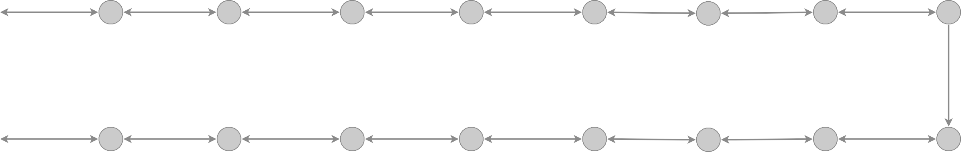
3-satisfiability reduces to directed Hamilton cycle
Construction. Given 3-SAT instance Φ with n variables x_{i} and k clauses.
・Construct G to have 2^{n} Hamilton cycles.
・Intuition: traverse path i from left to right ⇔ set variable x_{i} = true.
s
x1
x2
x3
t

Slide 43
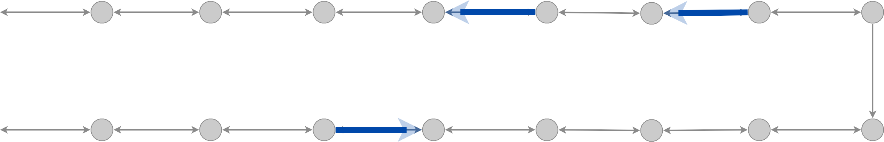
Intractability: quiz 5
Which is truth assignment corresponding to Hamilton cycle below?
x₁ = true, x₂ = true, x₃ = true C. x₁ = false, x₂ = false, x₃ = true
x₁ = true, x₂ = true, x₃ = false D. x₁ = false, x₂ = false, x₃ = false
s
x1
x2
x3
t
41

Slide 44
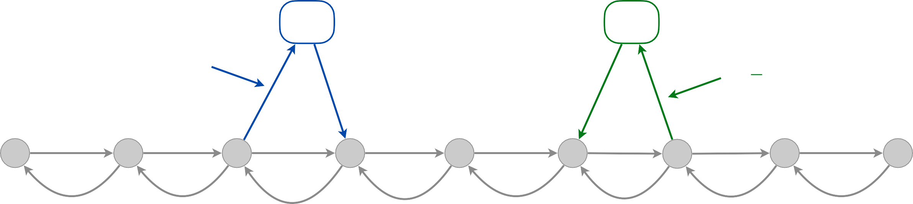
3-satisfiability reduces to directed Hamilton cycle
Construction. Given 3-SAT instance Φ with n variables x_{i} and k clauses.
・For each clause: add a node and 2 edges per literal.
node for clause j
node for clause k
Cj
Ck
connect in this way
if xi appears in clause Cj
connect in this way
if xi appears in clause Ck
xi
xi = true
xi = false
42

Slide 45
3-satisfiability reduces to directed Hamilton cycle
Construction. Given 3-SAT instance Φ with n variables x_{i} and k clauses.
・For each clause: add a node and 2 edges per literal.
C₁ = x₁ V x₂ V x₃
clause node 1
clause node 2
C₂ = x₁ V x₂ V x₃
s
x1
x2
x3
t
3k + 3
43

Slide 46
3-satisfiability reduces to directed Hamilton cycle
Lemma.
Φ is satisfiable iff G has a Hamilton cycle.
Pf. ⇒
・Suppose 3-SAT instance Φ has satisfying assignment x*.
・Then, define Hamilton cycle Γ in G as follows:
-
-
-
if x* = true, traverse row i from left to right
i
if x* = false, traverse row i from right to left
i
for each clause C_{j} , there will be at least one row i in which we are
going in “correct” direction to splice clause node C_{j} into cycle (and we splice in C_{j} exactly once) ▪

Slide 47
3-satisfiability reduces to directed Hamilton cycle
Lemma.
Φ is satisfiable iff G has a Hamilton cycle.
Pf. ⇐
・Suppose G has a Hamilton cycle Γ.
・If Γ enters clause node C_{j} , it must depart on mate edge.
-
-
nodes immediately before and after C_{j} are connected by an edge e ∈ E
removing C_{j} from cycle, and replacing it with edge e yields Hamilton
cycle on G – { C_{j} }
・Continuing in this way, we are left with a Hamilton cycle Γʹ in
G – { C₁ , C₂ , …, C_{k} }.
・
Set x = true if Γʹ traverses row i left-to-right; otherwise, set x
= false.
* *
i i
・traversed in “correct” direction, and each clause is satisfied. ▪

Slide 48
Poly-time reductions
constraint satisfaction
3-SAT
ET
poly-time reduces
-S
AT
NDEPENDENT
3-S
to I
Independent-Set
Dir-Ham-Cycle
3-Color
Subset-Sum
Vertex-Cover
Ham-Cycle
Knapsack
Set-Cover
packing and covering
sequencing
partitioning
numerical

Slide 49
NP-Complete Explained (Cook-Levin Theorem)
网络视频
https://www.youtube.com/watch?v=W9G_1xG77LE
温馨提示：此视频框在点击“上传手机课件”时会进行转换，用手机进行观看时则会变为可点击的视频。此视频框可被拖动移位和修改大小。

Slide 50


Slide 51
8. Intractability I
poly-time reductions
packing and covering problems
constraint satisfaction problems
sequencing problems
partitioning problems
graph coloring
numerical problems
Section 8.6

Slide 52
3-dimensional matching
3D-MATCHING. Given n instructors, n courses, and n times, and a list of the possible courses and times each instructor is willing to teach, is it possible to make an assignment so that all courses are taught at different times?
instructor | course | time
Wayne | COS 226 | TTh 11–12:20
Wayne | COS 423 | MW 11–12:20
Wayne | COS 423 | TTh 11–12:20
Tardos | COS 423 | TTh 3–4:20
Tardos | COS 523 | TTh 3–4:20
Kleinberg | COS 226 | TTh 3–4:20
Kleinberg | COS 226 | MW 11–12:20
Kleinberg | COS 423 | MW 11–12:20

Slide 53
3-dimensional matching
3D-MATCHING. Given 3 disjoint sets X, Y, and Z, each of size n and a set T ⊆ X × Y × Z of triples, does there exist a set of n triples in T such that each element of X ∪ Y ∪ Z is in exactly one of these triples?
X = { x1, x2, x3 },
Y = { y1, y2, y3 },
Z = { z1, z2, z3 }
T₁ = { x1, y1, z2 },
T₄ = { x2, y2, z3 },
T₇ = { x3, y1, z3 },
T₂ = { x1, y2, z1 },
T₅ = { x2, y3, z3 },
T₈ = { x3, y1, z1 },
T₃ = { x1, y2, z2 }
T₉ = { x3, y2, z1 }
an instance of 3d-matching (with n = 3)
Remark. Generalization of bipartite matching.

Slide 54
3-dimensional matching
3D-MATCHING. Given 3 disjoint sets X, Y, and Z, each of size n and a set T ⊆ X × Y × Z of triples, does there exist a set of n triples in T such that each element of X ∪ Y ∪ Z is in exactly one of these triples?
Theorem. 3-SAT ≤ _{P} 3D-MATCHING.
Pf. Given an instance Φ of 3-SAT, we construct an instance of 3D-MATCHING that has a perfect matching iff Φ is satisfiable.

Slide 55


3-satisfiability reduces to 3-dimensional matching
Construction. (part 1)
number of clauses
・Create gadget for each variable xi with 2k core elements and 2k tip ones.
clause 2 tips
clause 1 tips
core elements
clause 3 tips
a gadget for variable xi (k = 4)

Slide 56

3-satisfiability reduces to 3-dimensional matching
Construction. (part 1)
number of clauses
・Create gadget for each variable xi with 2k core elements and 2k tip ones.
・No other triples will use core elements.
・In gadget for xi, any perfect matching must use either all gray triples (corresponding to xi = true) or all blue ones (corresponding to xi = false).
false
clause 1 tips
core
true
k = 2 clauses n = 3 variables
clause 2 tips
x1
x2
x3

Slide 57
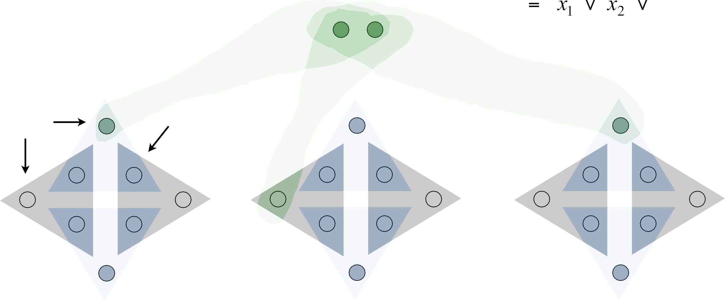
3-satisfiability reduces to 3-dimensional matching
Construction. (part 2)
・Create gadget for each clause Cj with two elements and three triples.
・Exactly one of these triples will be used in any 3d-matching.
・Ensures any perfect matching uses either (i) grey core of x1 or
(ii) blue core of x2 or (iii) grey core of x3.
clause 1 gadget
each clause assigned its own 2 adjacent tips
C1
false
clause 1 tips
core
true
x1
x2
x3

Slide 58
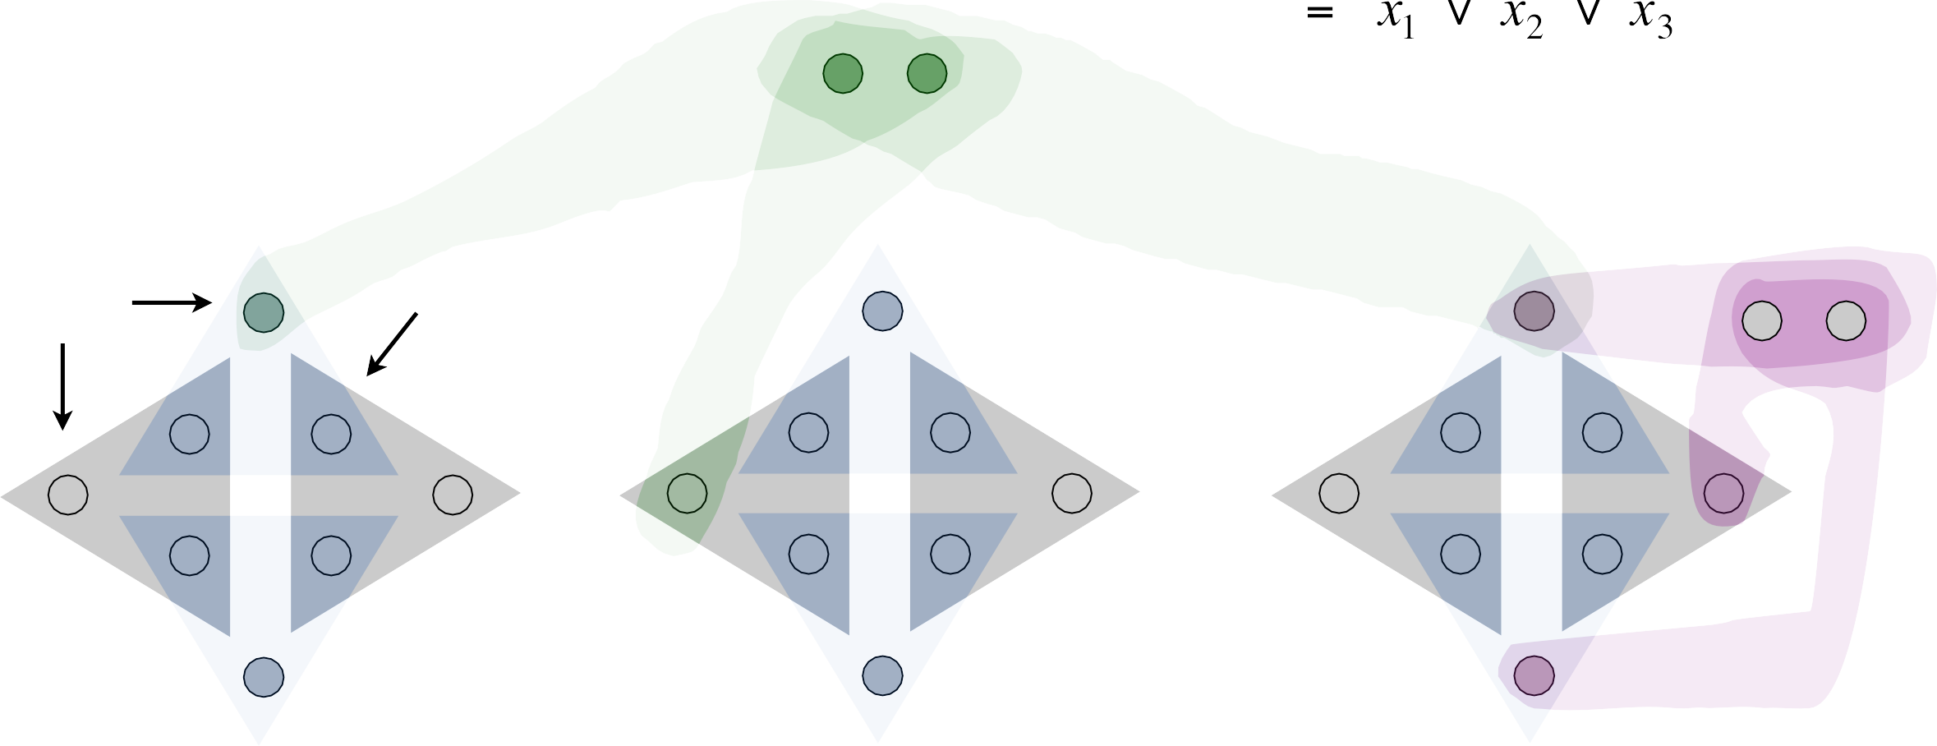
3-satisfiability reduces to 3-dimensional matching
Construction. (part 3)
・There are 2 n k tips:
n k covered by blue/gray triples; k by clause triples.
・To cover remaining (n – 1) k tips, create (n – 1) k cleanup gadgets: same as clause gadget but with 2 n k triples, connected to every tip.
clause 1 gadget
C1
false
cleanup gadget
clause 1 tips
core
···
true
x1
x2
x3

Slide 59

3-satisfiability reduces to 3-dimensional matching
Lemma. Instance (X, Y, Z) has a perfect matching iff Φ is satisfiable.
Q. What are X, Y, and Z ?
clause 1 gadget
C1
false
cleanup gadget
clause 1 tips
core
···
true
x1
x2
x3

Slide 60
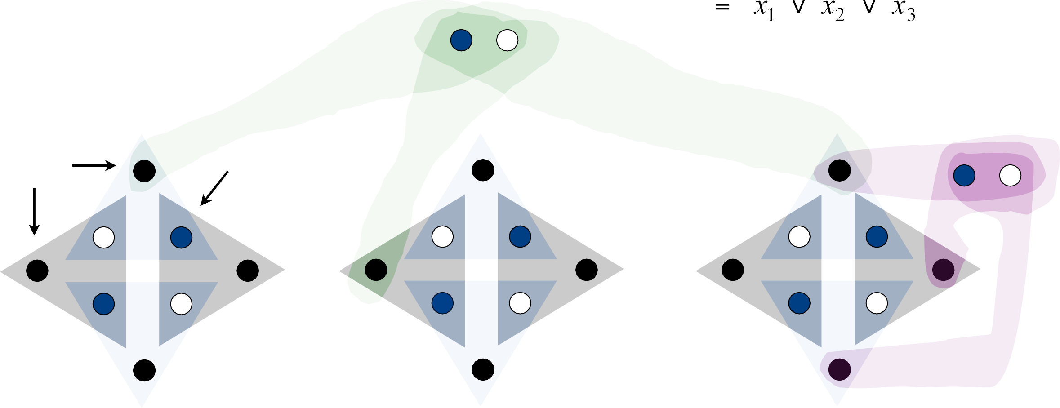
3-satisfiability reduces to 3-dimensional matching
Lemma. Instance (X, Y, Z) has a perfect matching iff Φ is satisfiable.
Q. What are X, Y, and Z ?
A. X = black, Y = white, and Z = blue.
clause 1 gadget
C1
false
cleanup gadget
clause 1 tips
core
···
true
x1
x2
x3

Slide 61

3-satisfiability reduces to 3-dimensional matching
Lemma. Instance (X, Y, Z) has a perfect matching iff Φ is satisfiable.
Pf. ⇒ If 3d-matching, then assign xi according to gadget xi.
Pf. ⇐ If Φ is satisfiable, use any true literal in Cj to select gadget Cj triple. ▪
clause 1 gadget
C1
false
cleanup gadget
clause 1 tips
core
···
true
x1
x2
x3

Slide 62
8. Intractability I
poly-time reductions
packing and covering problems
constraint satisfaction problems
sequencing problems
partitioning problems
graph coloring
numerical problems
Section 8.7

Slide 63
3-colorability
3-COLOR. Given an undirected graph G, can the nodes be colored black, white, and blue so that no adjacent nodes have the same color?
yes instance
59

Slide 64
Intractability: quiz 6
How difficult to solve 2-COLOR?
O(m + n) using BFS or DFS.
O(mn) using maximum flow.
Ω(2^{n}) using brute force.
Not even Tarjan knows.
60

Slide 65
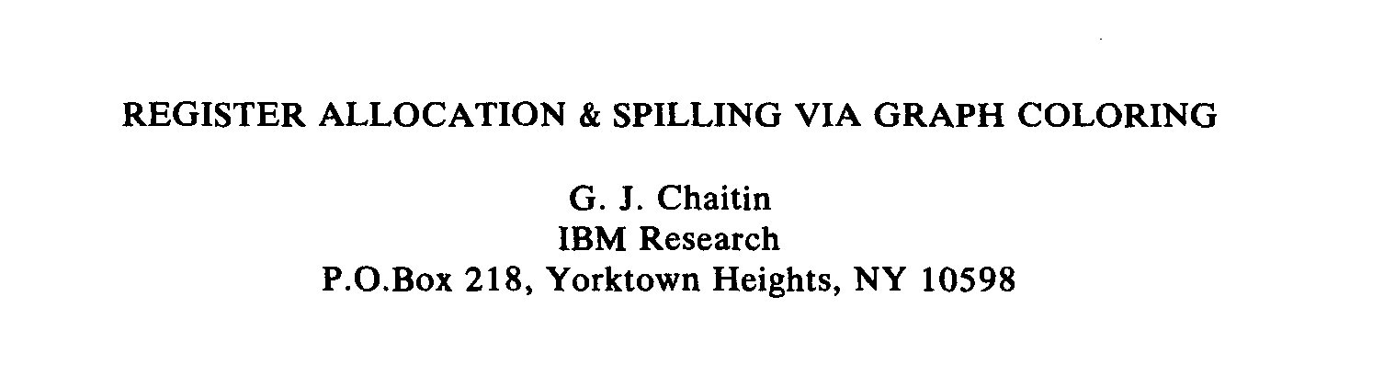
Application: register allocation
Register allocation. Assign program variables to machine registers so that no more than k registers are used and no two program variables that are needed at the same time are assigned to the same register.
Interference graph. Nodes are program variables; edge between u and v
if there exists an operation where both u and v are “live” at the same time.
Observation. [Chaitin 1982] Can solve register allocation problem iff interference graph is k-colorable.
Fact. 3-COLOR ≤ _{P} K-REGISTER-ALLOCATION for any constant k ≥ 3.

Slide 66
3-satisfiability reduces to 3-colorability
Theorem. 3-SAT ≤ _{P} 3-COLOR.
Pf. Given 3-SAT instance Φ, we construct an instance of 3-COLOR that is 3-colorable iff Φ is satisfiable.

Slide 67
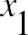
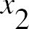
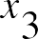
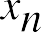
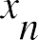
3-satisfiability reduces to 3-colorability
Construction.
Create a graph G with a node for each literal.
Connect each literal to its negation.
Create 3 new nodes T, F, and B; connect them in a triangle.
Connect each literal to B.
For each clause Cj, add a gadget of 6 nodes and 13 edges.
to be described later
T
F
B

Slide 68
3-satisfiability reduces to 3-colorability
Lemma. Graph G is 3-colorable iff Φ is satisfiable. Pf. ⇒ Suppose graph G is 3-colorable.
・WLOG, assume that node T is colored black, F is white, and B is blue.
・Consider assignment that sets all black literals to true (and white to false).
・(iv) ensures each literal is colored either black or white.
・(ii) ensures that each literal is white if its negation is black (and vice versa).
true
T
false
F
base
B

Slide 69

3-satisfiability reduces to 3-colorability
Lemma. Graph G is 3-colorable iff Φ is satisfiable. Pf. ⇒ Suppose graph G is 3-colorable.
・WLOG, assume that node T is colored black, F is white, and B is blue.
・Consider assignment that sets all black literals to true (and white to false).
・(iv) ensures each literal is colored either black or white.
・(ii) ensures that each literal is white if its negation is black (and vice versa).
・(v) ensures at least one literal in each clause is black.
B
C_{j} = x₁ ∨ x₂ ∨ x₃
6-node gadget
true
T
F
false

Slide 70
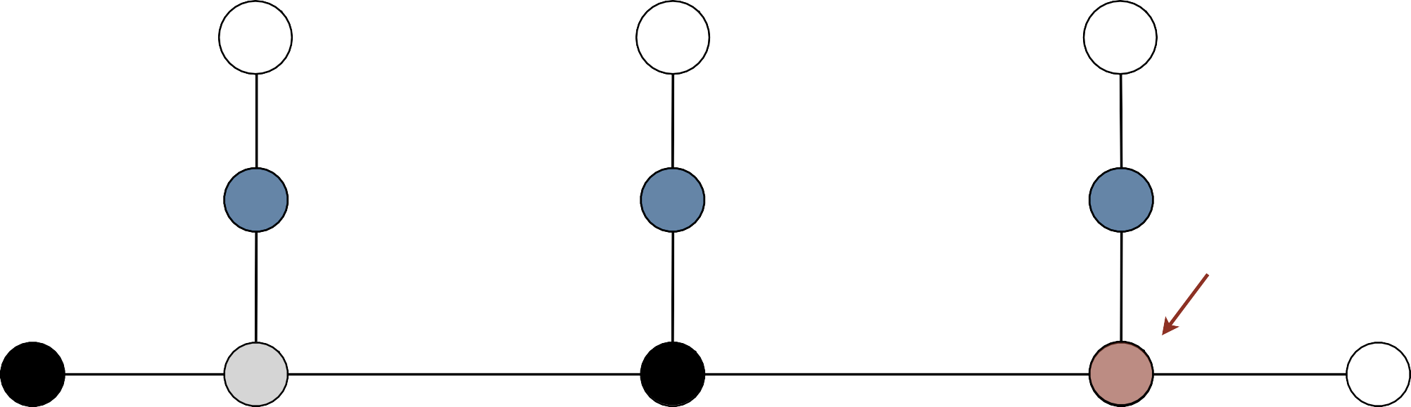

3-satisfiability reduces to 3-colorability
Lemma. Graph G is 3-colorable iff Φ is satisfiable. Pf. ⇒ Suppose graph G is 3-colorable.
・WLOG, assume that node T is colored black, F is white, and B is blue.
・Consider assignment that sets all black literals to true (and white to false).
・(iv) ensures each literal is colored either black or white.
・(ii) ensures that each literal is white if its negation is black (and vice versa).
・(v) ensures at least one literal in each clause is black. ▪
suppose, for the sake of contradiction, that all 3 literals are white in some 3-coloring
B
C_{j} = x₁ ∨ x₂ ∨ x₃
contradiction (not a 3-coloring)
true
T
F
false

Slide 71
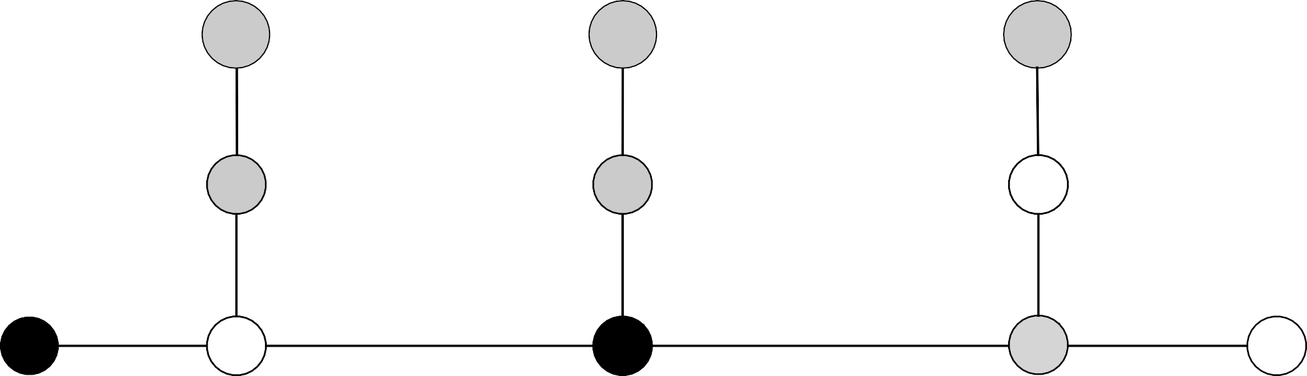
3-satisfiability reduces to 3-colorability
Lemma. Graph G is 3-colorable iff Φ is satisfiable. Pf. ⇐ Suppose 3-SAT instance Φ is satisfiable.
・Color all true literals black and all false literals white.
・Pick one true literal; color node below that node white, and node below that blue.
・Color remaining middle row nodes blue.
・Color remaining bottom nodes black or white, as forced. ▪
a literal set to true in 3-SAT assignment
B
x3
C_{j} = x₁ ∨ x₂ ∨ x₃
true
T
F
false

Slide 72
Poly-time reductions
constraint satisfaction
3-SAT
ET
poly-time reduces
-S
AT
NDEPENDENT
3-S
to I
Independent-Set
Dir-Ham-Cycle
3-Color
Subset-Sum
Vertex-Cover
Ham-Cycle
Knapsack
Set-Cover
packing and covering
sequencing
partitioning
numerical

Slide 73
8. Intractability I
poly-time reductions
packing and covering problems
constraint satisfaction problems
sequencing problems
partitioning problems
graph coloring
numerical problems
Section 8.8

Slide 74
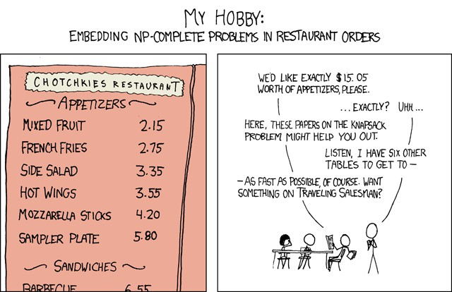
My hobby
NP-Complete by Randall Munro http://xkcd.com/287
Creative Commons Attribution-NonCommercial 2.5

Slide 75
Subset sum
SUBSET-SUM. Given n natural numbers w₁, …, w_{n} and an integer W, is there a subset that adds up to exactly W ?
Ex. { 215, 215, 275, 275, 355, 355, 420, 420, 580, 580, 655, 655 }, W = 1505.
Yes. 215 + 355 + 355 + 580 = 1505.
Remark. With arithmetic problems, input integers are encoded in binary. Poly-time reduction must be polynomial in binary encoding.

Slide 76
Subset sum
Theorem. 3-SAT ≤ _{P} SUBSET-SUM.
Pf. Given an instance Φ of 3-SAT, we construct an instance of SUBSET-SUM that has a solution iff Φ is satisfiable.

Slide 77
3-satisfiability reduces to subset sum
Construction. Given 3-SAT instance Φ with n variables and k clauses, form 2n + 2k decimal integers, each having n + k digits:
・Include one digit for each variable xi and one digit for each clause Cj.
・Include two numbers for each variable xi.
・Include two numbers for each clause Cj.
・Sum of each xi digit is 1; sum of each Cj digit is 4.
Key property. No carries possible ⇒
each digit yields one equation.
x1 |  | 100,010
¬ x1 |  | 100,101
x2 |  | 10,100
¬ x2 |  | 10,011
x3 |  | 1,110
¬ x3 |  | 1,001 100 200 10 20 1
x1 | x2 | x3 | C1 | C2 | C3
1 | 0 | 0 | 0 | 1 | 0
1 | 0 | 0 | 1 | 0 | 1
0 | 1 | 0 | 1 | 0 | 0
0 | 1 | 0 | 0 | 1 | 1
0 | 0 | 1 | 1 | 1 | 0
0 | 0 | 1 | 0 | 0 | 1
0 | 0 | 0 | 1 | 0 | 0
0 | 0 | 0 | 2 | 0 | 0
0 | 0 | 0 | 0 | 1 | 0
0 | 0 | 0 | 0 | 2 | 0
0 | 0 | 0 | 0 | 0 | 1
0 | 0 | 0 | 0 | 0 | 2
1 | 1 | 1 | 4 | 4 | 4
C1 = | ¬ x1 | ∨ | x₂ ∨ | x3
C2 = | x1 | ∨ | ¬ x2 ∨ | x3
C3 = | ¬ x1 | ∨ | ¬ x2 ∨ | ¬ x3
dummies to get clause columns to sum to 4
2
3-SAT instance
W
111,444
SUBSET-SUM instance

Slide 78
3-satisfiability reduces to subset sum
Lemma. Φ is satisfiable iff there exists a subset that sums to W. Pf. ⇒ Suppose 3-SAT instance Φ has satisfying assignment x*.
・ i
If x = true
, select integer in row x ;
*
i
otherwise, select integer in row ¬ xi.
・Each xi digit sums to 1.
・Since Φ is satisfiable, each Cj digit sums to at least 1 from xi and ¬ xi rows.
・Select dummy integers to make
Cj digits sum to 4. ▪
x1 |  | 100,010
¬ x1 |  | 100,101
x2 |  | 10,100
¬ x2 |  | 10,011
x3 |  | 1,110
¬ x3 |  | 1,001 100 200 10 20 1
x1 | x2 | x3 | C1 | C2 | C3
1 | 0 | 0 | 0 | 1 | 0
1 | 0 | 0 | 1 | 0 | 1
0 | 1 | 0 | 1 | 0 | 0
0 | 1 | 0 | 0 | 1 | 1
0 | 0 | 1 | 1 | 1 | 0
0 | 0 | 1 | 0 | 0 | 1
0 | 0 | 0 | 1 | 0 | 0
0 | 0 | 0 | 2 | 0 | 0
0 | 0 | 0 | 0 | 1 | 0
0 | 0 | 0 | 0 | 2 | 0
0 | 0 | 0 | 0 | 0 | 1
0 | 0 | 0 | 0 | 0 | 2
1 | 1 | 1 | 4 | 4 | 4
∨
∨
∨
x2
¬ x2
¬ x2
∨
∨
∨
x3 x3
¬ x3
C1 | = | ¬ x1
C2 | = | x1
C3 | = | ¬ x1
dummies to get clause columns to sum to 4
2
3-SAT instance
W
111,444
SUBSET-SUM instance

Slide 79
3-satisfiability reduces to subset sum
Lemma. Φ is satisfiable iff there exists a subset that sums to W. Pf. ⇐ Suppose there exists a subset S* that sums to W.
・Digit xi forces subset S* to select either row xi or row ¬ xi (but not both).
・
If row x selected, assign x = true ; otherwise, assign
x* = false.
i
i
*
i
Digit Cj forces subset S* to select at least one literal in clause. ▪
x1 |  | 100,010
¬ x1 |  | 100,101
x2 |  | 10,100
¬ x2 |  | 10,011
x3 |  | 1,110
¬ x3 |  | 1,001 100 200 10 20 1
x1 | x2 | x3 | C1 | C2 | C3
1 | 0 | 0 | 0 | 1 | 0
1 | 0 | 0 | 1 | 0 | 1
0 | 1 | 0 | 1 | 0 | 0
0 | 1 | 0 | 0 | 1 | 1
0 | 0 | 1 | 1 | 1 | 0
0 | 0 | 1 | 0 | 0 | 1
0 | 0 | 0 | 1 | 0 | 0
0 | 0 | 0 | 2 | 0 | 0
0 | 0 | 0 | 0 | 1 | 0
0 | 0 | 0 | 0 | 2 | 0
0 | 0 | 0 | 0 | 0 | 1
0 | 0 | 0 | 0 | 0 | 2
1 | 1 | 1 | 4 | 4 | 4
∨
∨
∨
x2
¬ x2
¬ x2
∨
∨
∨
x3 x3
¬ x3
C1 | = | ¬ x1
C2 | = | x1
C3 | = | ¬ x1
dummies to get clause columns to sum to 4
2
3-SAT instance
W
111,444
SUBSET-SUM instance

Slide 80
Subset sum reduces to knapsack
SUBSET-SUM. Given n natural numbers w₁, …, w_{n} and an integer W, is there a subset that adds up to exactly W ?
KNAPSACK. Given a set of items X, weights ui ≥ 0, values vi ≥ 0, a weight limit
U, and a target value V, is there a subset S ⊆ X such that:
Σ Σ
$18
5 kg
$22
6 kg
u ≤ U, v ≥ V
11 kg
i i
i S i S
$6
2 kg
$1
1 kg
$28
7 kg
Recall. O(n U) dynamic programming algorithm for KNAPSACK.
Challenge. Prove SUBSET-SUM ≤ P KNAPSACK.
Pf. Given instance (w1, …, wn, W) of SUBSET-SUM, create KNAPSACK instance:
^{Σ}i S ^{Σ}i S
u_{i} = v_{i} = w_{i}
w_{i} ≤ W, w_{i} ≥ W
U = V = W
76

Slide 81
Poly-time reductions
constraint satisfaction
3-SAT
ET
poly-time reduces
-S
AT
NDEPENDENT
3-S
to I
Independent-Set
Dir-Ham-Cycle
3-Color
Subset-Sum
Vertex-Cover
Ham-Cycle
Knapsack
Set-Cover
packing and covering
sequencing
partitioning
numerical

Slide 82
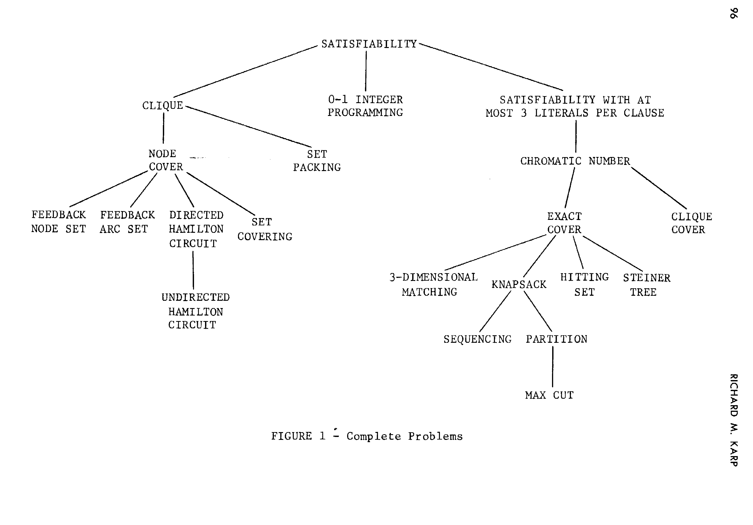
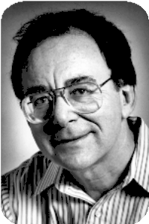
Karp’s 20 poly-time reductions from satisfiability
Dick Karp (1972)
1985 Turing Award

